Slide 1
Digital Business and E-Commerce Management
Lesson 5
Digital Business Strategy

Slide 2
Digital Business Strategy
At the end of this lesson, you will be able to
Follow an appropriate process model for digital business
1
Apply tools to generate and select digital business strategies
2
Outline alternative strategic approaches to achieve digital business
3

Slide 3
Activity 5.1
Refer to your book for Activity 5.1

Slide 4
Introduction
Developing a digital business strategy requires a fusion of existing approaches to business, marketing, supply chain management and information systems strategy development.

Slide 5
Four-staged strategy process model
Strategic Evaluation
Strategic Objectives
Strategy Definition
Strategy Implementation

Slide 6
What is digital business Strategy?
Strategy
- Direction and scope of an organization over the long-term which achieves advantage for an organization through its configuration of resources within a changing environment to meet the needs of the markets and fulfil stakeholder expectations.

Slide 7
What is digital business Strategy?
Approach by which application of internal and external electronic communication can support and influence business strategy.
These strategies may be buy-side, sell-side or internal infrastructure.

Slide 8
What is digital business Strategy?
There is a tendency for digital business strategy to be incorporated within the functional strategies, for example within a marketing plan or logistics plan, or as part of information systems (IS) strategy.

Slide 9
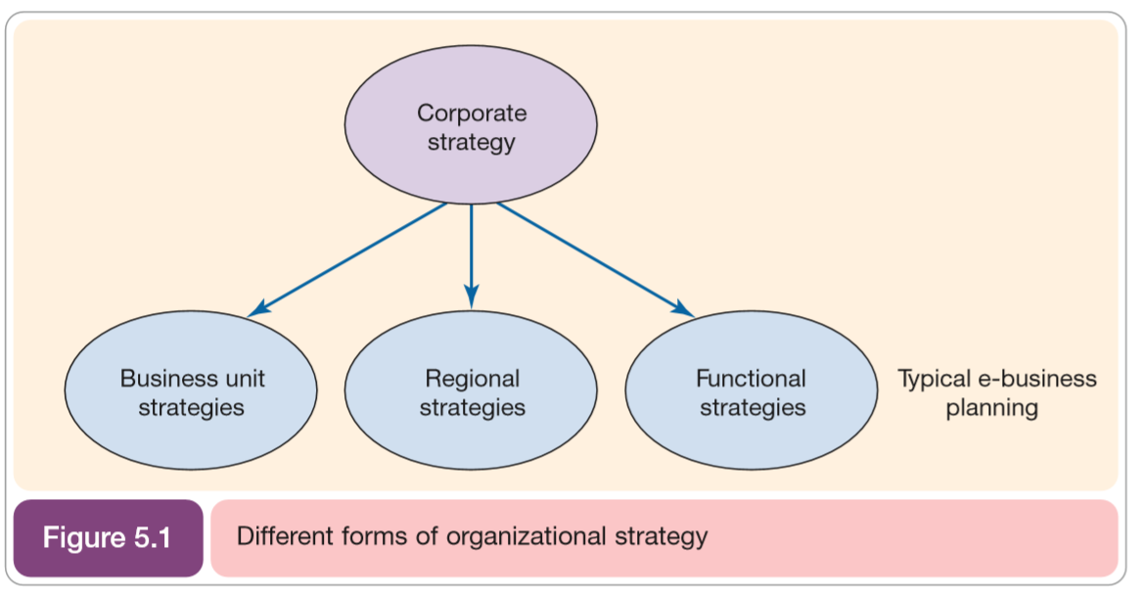
What is digital business strategy? (Different forms of Organizational strategy)
Typical digital business planning

Slide 10
Activity 5.2
Refer to your book for Activity 5.2

Slide 11
What is digital business strategy? (Digital Channel Strategies)
Digital Channel Strategies - Define how a company should set specific objectives and develop specific differential strategies for communicating with its customers and partners through electronic media
Examples of digital channel strategies
Mobile commerce strategy
Social media strategy
Social CRM strategy
Supply chain or enterprise resource planning strategy
E-procurement strategy

Slide 12
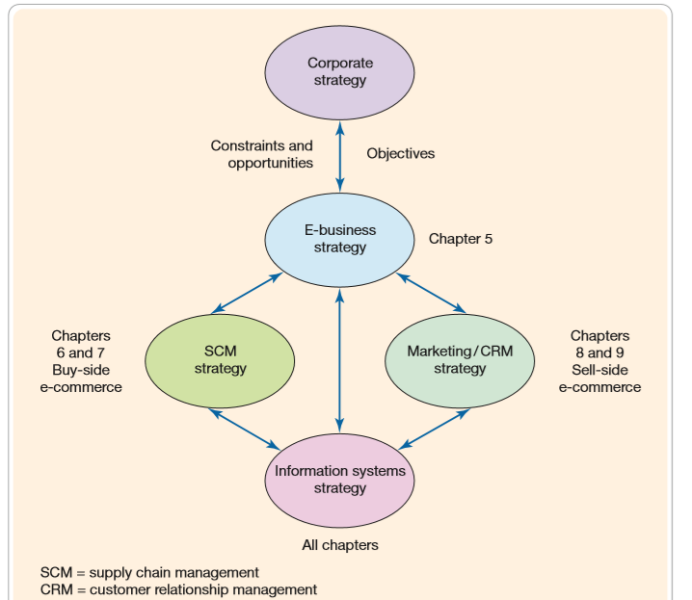
What is digital business strategy? (Relationship between digital strategy and other strategies)

Slide 13
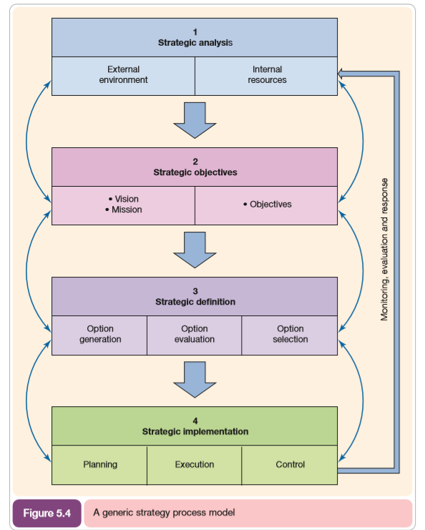
What is digital business strategy? (Strategy process model for digital business)

Slide 14
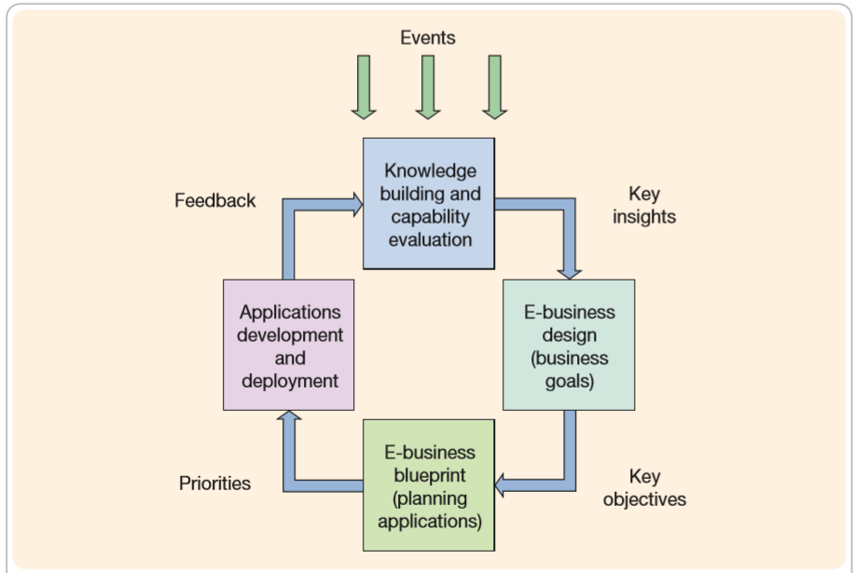
What is digital business strategy? (Dynamic digital strategy model)

Slide 15
Activity 5.3
Refer to your book for Activity 5.3

Slide 16
1. Strategic Analysis
Collection and review of information about an organization’s internal processes and resources and external marketplace factors in order to inform strategy definition.

Slide 17
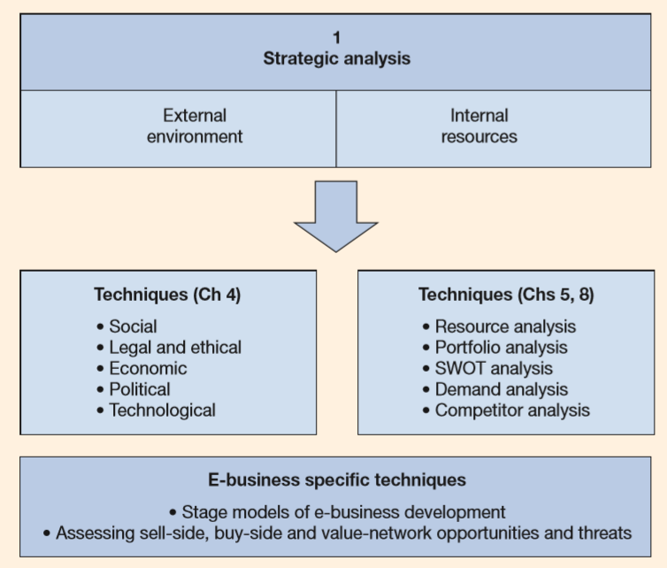
Strategic Analysis (Resource and Process Analysis)
Stage models are helpful in reviewing how advanced a company is in tis use of information and communication technology (ICT) resources to support its processes.
Elements of strategic situation analysis for the digital business

Slide 18
Strategic Analysis (For existing companies the stages are: )
Image and product information
A basic “brochureware” website or presence in online directories
Information
Enquiries are facilitated through online forms
Customer support and service
“Web self-service” through a forum or online
Internal support and service
A marketing intranet to help with support process
Transactions
Online sales or the creation of an e-CRM system

Slide 19
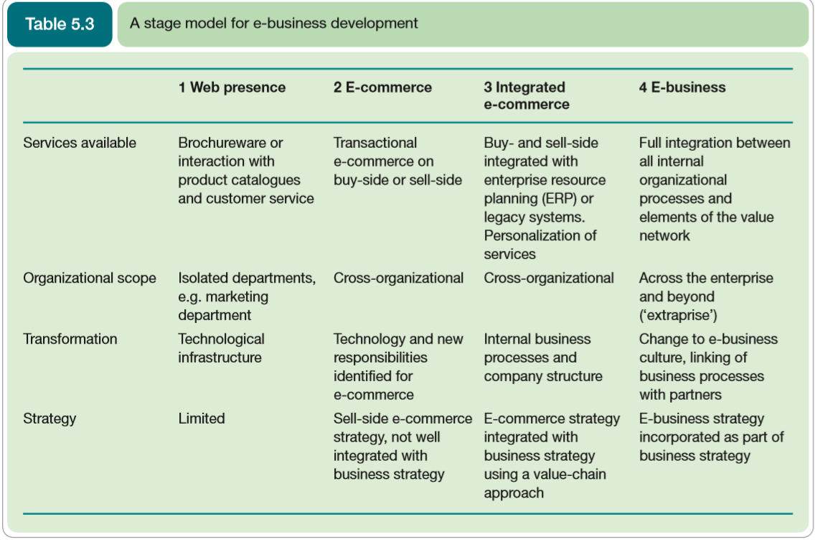
Strategic Analysis (Stage model for digital business development)

Slide 20
Strategic Analysis (Application portfolio analysis)
Analysis of the current portfolio of business applications within a business is used to assess current information system capability and also to inform future strategies.
Also often used to select the most appropriate future Internet projects

Slide 21
Strategic Analysis (Benchmarking current digital business priorities) 1- Digital Channel Strategy
The development of a clear strategy, including:
situational analysis
goal setting
Identification of key target markets and audience
Identification of priorities for development of online service

Slide 22
Strategic Analysis (Benchmarking current digital business priorities) 2- Online Customer Acquisition
Strategies for gaining new customers online using alternative digital media channels, including:
Search Engine Marketing
Partner Marketing
Display Advertising

Slide 23
Strategic Analysis (Benchmarking current digital business priorities) 3- Online Customer conversion and experience
Approaches to improve online service levels and increase conversion to sales or other online outcomes.

Slide 24
Strategic Analysis (Benchmarking current digital business priorities) 4- Customer development and growth
Strategies to encourage visitors and customers to continue using online services using tactics such as e-mail marketing and personalization.

Slide 25
Strategic Analysis (Benchmarking current digital business priorities) 5- Cross-channel integration and brand development
Integrating online sales and service with customer communications and service interactions in physical channels.

Slide 26
Strategic Analysis (Benchmarking current digital business priorities) 6- Digital channel governance
Issues in managing digital business services such as structure and resourcing, including:
human resource
technology infrastructure such as hardware and networking facilities to deliver these applications

Slide 27
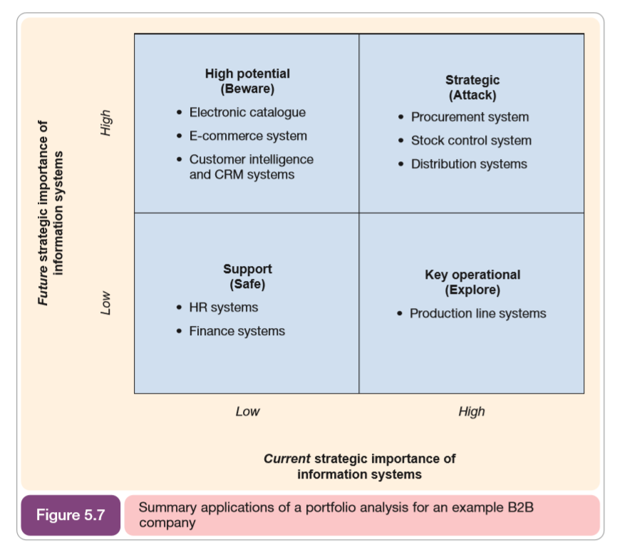
Strategic Analysis
Illustrates the results of a portfolio analysis for B2B company applied within a digital business context.

Slide 28
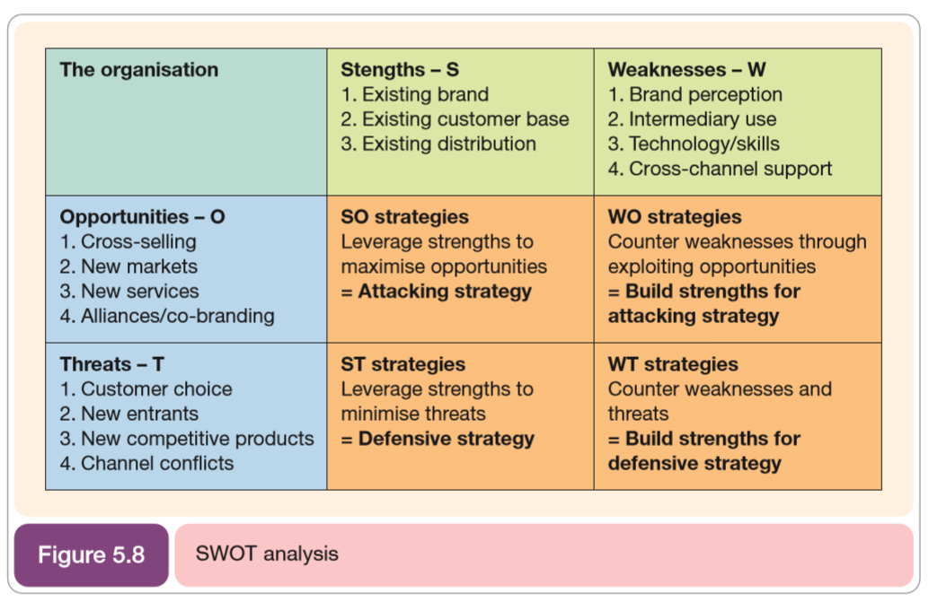
Strategic Analysis (SWOT Analysis)

Slide 29
Activity 5.4
Refer to your book for Activity 5.4

Slide 30

2. Strategic Objectives
Statement and communication of an organization’s mission, vision and objectives.
Defining and communicating an organization’s strategic objectives is a key element of any strategy process model

Slide 31
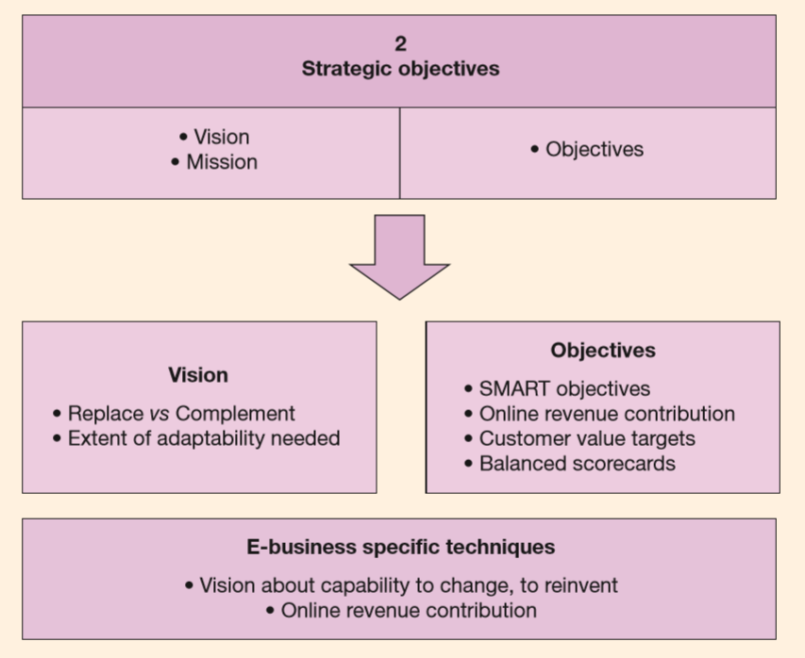
Strategic Objectives (Elements of strategic objective setting for digital business)
Key aspects of strategic objective setting

Slide 32
Strategic Objectives (Methods in which digital business can add value to an organization)
Adding value
Reduce costs
Manage risks
Create new reality

Slide 33
Strategic Objective (Objective Setting)
An effective strategy development process links general goals, strategies and more specific objectives and performance measures.
One method of achieving this linkage is through tabulations.

Slide 34
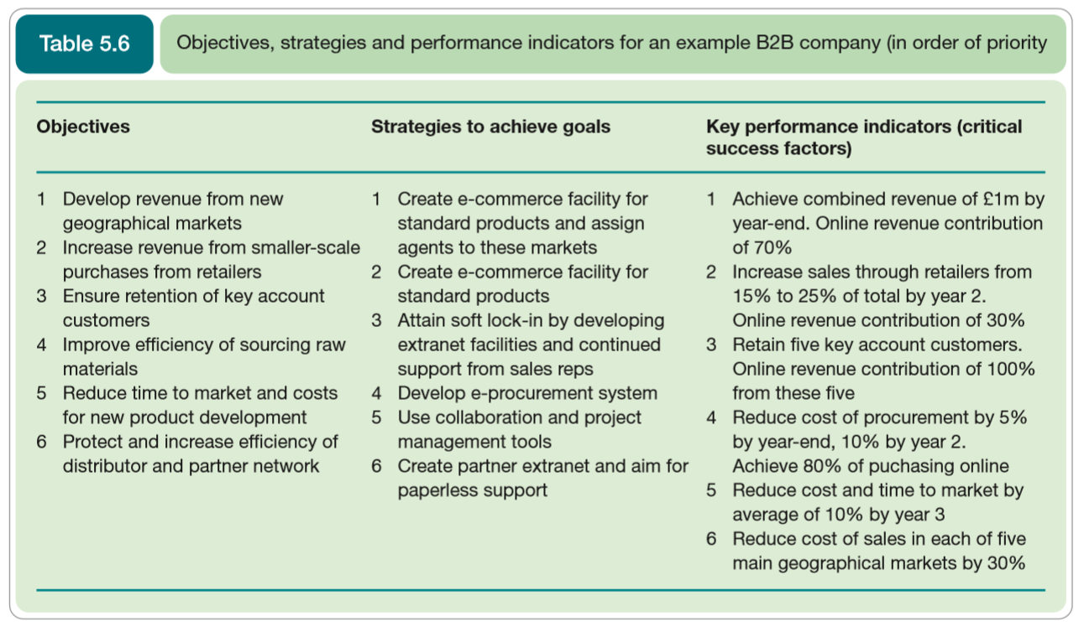
Strategic Objective (Objective Setting)

Slide 35
Activity 5.5
Refer to your book for Activity 5.5

Slide 36
Strategic Objective (Setting SMART objectives)
SMART is used to assess the suitability of objectives set to drive different strategies or the improvement of the full range of business processes
Specific. Is the objective sufficiently detailed to measure real world problems and opportunities?
Measurable. Can a quantitative or qualitative attribute be applied to create a metric?
Actionable. Can the information be used to improve performance?
Relevant. Can the information be applied to the specific problem faced by the manage?
Time-related. Does the measure or goal relate to a definite time-frame?

Slide 37
Strategic Objective (The balance score card approach to objective settings)
The main areas of the balanced scorecard are:
Customer concerns. Includes time, quality, performance, service and cost.
Internal measures. Based on the business processes that have the greatest impact on customer satisfaction.
Financial measures. Traditional measures such as turnover, costs, profitability and return on capital employed.
Learning and growth. Innovation and staff development

Slide 38
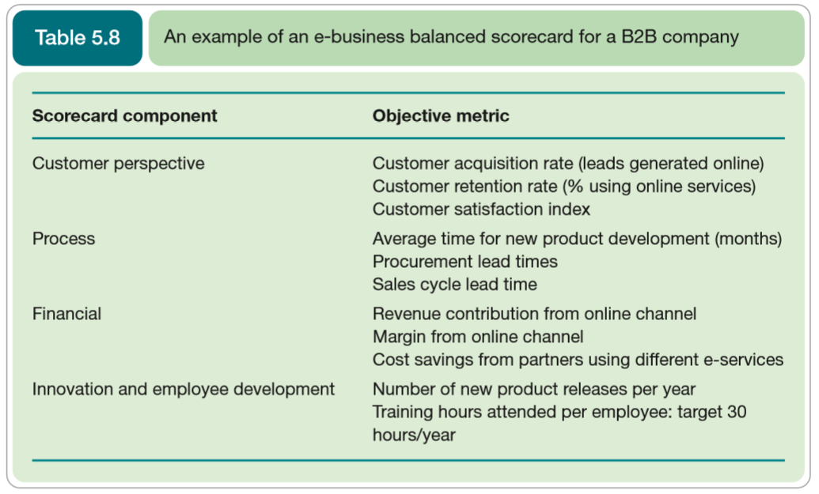
Strategic Objective (The balance score card approach to objective settings)
The balanced scorecard provides a framework for the entire business strategy process.

Slide 39
3. Strategy Definition
Formulation, review and selection of strategies to achieve strategic objectives.
As strategy is formulated based on vision and objectives, so it is necessary to frequently revisit an revise them.

Slide 40
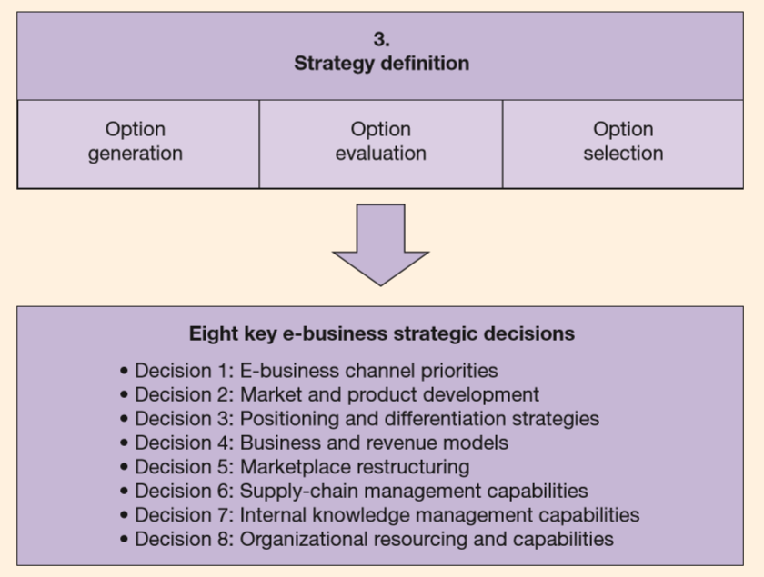
Strategy Definition
Elements of strategy definition for the digital business

Slide 41
Strategy Definition (Selection of digital business strategy options)
When reviewing digital business strategy options, there will be a range of possible strategies and digital business service alternatives to be evaluated.
Limited resources will dictate that only some applications are practical.

Slide 42
Strategy Definition (Selection of digital business strategy options)
Typical options for an organization which has a brochureware site might be to implement:
Transactional e-commerce facility
Online Catalogue facility
e-CRM – lead generation system
e-CRM – customer service management
e-CRM – personalization of contents for users
e-procurement system for office supplies
social network or customer forum

Slide 43
Activity 5.6
Refer to your book for Activity 5.6

Slide 44
4. Strategy Implementation
Includes all tactics used to achieve strategic objectives.
Planning, actions and controls needed to achieve strategic goals

Slide 45
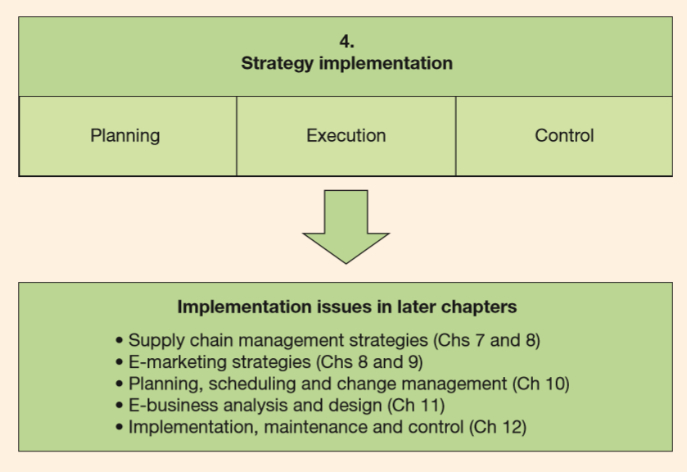
Strategy Implementation
Elements of strategy implementation for the digital business

Slide 46
Strategy Implementation (Reasons for failed digital business strategies)
Timing errors
Lack of creativity
Offering free services
Over ambition
Situation analysis
Objective setting
Strategy definition
Implementation

Slide 47
Strategy Implementation (Digital business strategy implementation success factors for SMEs)
Content – effective presentation of products and services
Convenience – the usability of the website
Interaction – the means of relationship building with the customers
Community – relationship building with groups or like-minded individuals or organization
Price-sensitivity – Sensitivity of a product or service to price competition on the Internet
Brand image – Ability to build up credible brand name
Commitment – motivation for using the Internet and the will to innovate
Process improvement – automation of business processes

Slide 48
Self-Assessment Questions
Refer to Activity booklet for questions which will help you review the topics covered in this lesson.

